Slide 1
Fostering Success Michigan Collective Impact Framework
From Passion to Action!
2nd Annual Fostering Success Michigan Summit

Slide 3
Large Scale Social Problem
We need to increase access and success in postsecondary education and professional careers for students from foster care ages 12-25 in Michigan.

Slide 4
Backbone Organization
Fostering Success Michigan supports Michigan’s network of experts versus being an “expert organization”.
Fostering Success Michigan utilizes 3 main strategies:
Resourcing
Supporting
Networking

Slide 5
Common Agenda
Fostering Success Michigan has adopted the Lumnia Big Goal of increasing the number of students from foster care who obtain high-quality degrees and credentials to 60% by the year 2025.

Slide 6
Common Agenda
The available estimate to date is that 21.5% of Michigan alumni of foster care have earned a diploma, certificate or college degree beyond high school graduation.
*White, C. R., O’Brien, K., Pecora, P.J., Kessler, R.C., Sampson, N., Hwang, I., and Buher, A. (November 2012). Michigan Foster Care Alumni Study Technical Report: Outcomes at Age 23 and 24. Casey Family Programs: Seattle, WA.

Slide 7
Mutually Reinforcing Activities
Each partner in the Fostering Success Michigan Network plays a vital role in the education to career pipeline for youth and alumni of foster care.
Through working together with the common goal everyone plays an important role in postsecondary education and professional career access and success for students from foster care.

Slide 8
Mutually Reinforcing Activities
Postsecondary Education Institutions’ staff and campus champions
Youth and Alumni of Foster Care
Middle and High School Educators and Staff
Community Organizations and Other Service Providers
Caregivers and Mentors
The Department of Human Services
Local College Access Networks,
The Department of Education
Courts, Law Enforcement and Juvenile Justice System
Career and Work Forces Services
Housing champions

Slide 9
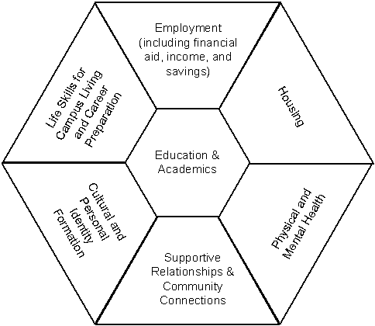
Shared Measurement
A shared measurement strategy is being established through the collaborative efforts of the Fostering Success Michigan Higher Education Consortium (FSM HEC).
To provide a realistic understanding of how Michigan’s youth from foster care transition to young adulthood and move through postsecondary education and into professional careers, the FSM HEC has identified indicators in each of the 7 domains, adapted from the Casey Family Programs It’s My Life framework.

Slide 10
Continuous Communication

Slide 11
Continuous Communication
To ensure that our diverse group of partners maintains an awareness of successes, challenges, priority issues and shared solutions, FSM will support continuous communication through:
The FSM Google Group listserv
FSM Regional Network Meetings
The FSM Annual Summit
The FSM statewide resource website

Slide 12
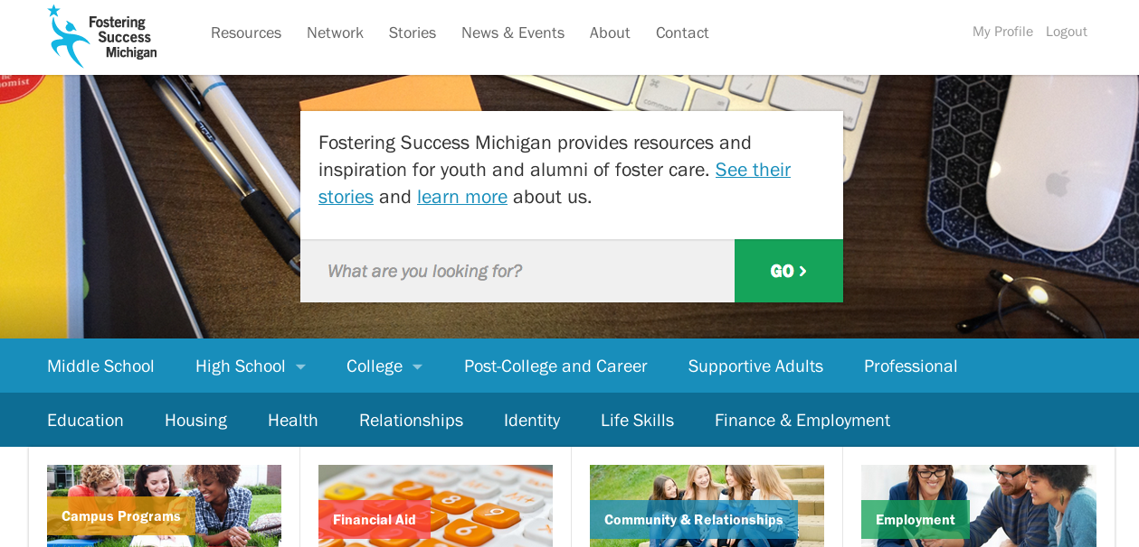
Continuous Communication
www.FosteringSuccessMichigan.com

Slide 13
For more information:
Maddy Day: maddy.day@wmich.edu, (269) 568-9142
www.FosteringSuccessMichigan.com
http://groups.google.com/group/fostering-success-michigan

