Slide 1
FOSTERING SUCCESS MICHIGAN
Network Webinar Series
Education & Foster Care: Stability for Students—It’s the Law!
Notes:
Static pic

Slide 2
Karie Ward, MSW
Director, Fostering Success Michigan
The New Foster Care
Notes:
Static pic

Slide 3
Education and Foster Care: Stability for students- It’s the Law
Kathleen Hoehne
Foster Care Consultant
Office of Educational Supports
Michigan Department of Education
Ann Rossi
Education Analyst
Education and Youth Services
Michigan Department of Health and Human Services

Slide 4
Agenda
Children’s Protective Services and Family Team Meetings
Fostering Connections Act of 2008
Every Student Succeeds Act of 2015
Education Best Interest Determination
Point-of-Contact and District Liaison Responsibilities
Transportation Collaboration
Updates

Slide 5
Children’s Protective Services (CPS)
CPS investigates allegations of child abuse/neglect.
Based on investigation, interviews and assessments some possible outcomes include:
Case may be closed based on no preponderance of evidence.
In-home services may be offered and/or required.
Children may be removed and placed in foster care with a licensed foster home, relatives, or residential.
Children may be placed with relatives and no foster care case opening (such as non-offending parent).
If when initially placed in foster care, the distance to school of origin is too great, enrollment in a new school may have to occur immediately without a formal best interest discussion.

Slide 6
Family team meeting (FTM)
A structured approach to involving youth, families, and caregivers in case planning through a facilitate meeting of family and their identified supports. (FOM 722-06B). FTM’s occur at the following points of a case:
Initial placement
Permanency goal review (6-months from coming into care)
Permanency goal change
Placement preservation/disruption/change
Semi-Annual transition (youth 14 and older)
90-Day discharge (youth 16 or older)
Case closure
If requested by family.

Slide 7
Family team meeting (FTM) cont.
The time from CPS investigation, removal, and transfer to foster care can be an overwhelmingly busy time.
Instructions to the field have been:
Best practice is to include school staff, even if by phone for initial placement and replacement FTMs.
If invited and unable to attend, worker can get school input prior to meeting.
Consider having the FTM at the school.
Transfer from CPS to foster care and getting a foster care worker assigned may take 5 days. The DHS-942 is a foster care required form, and not required by CPS.

Slide 8
Fostering Connections to Success and Increasing Adoptions Act of 2008
Education provisions of Fostering Connections require:
All case plans include assurances of educational stability.
Child welfare staff consider appropriateness of school and proximity to school of origin when making foster care placements/replacement.
Child welfare staff work with school staff to ensure children remain in the school of origin at time of placement.

Slide 9
Fostering Connections to Success and Increasing Adoptions Act of 2008 Cont.
When remaining in the school of origin is not found in the best interest of the student, the case plan must include assurances that the child welfare agencies have worked with the schools to:
Provide immediate and appropriate enrollment in a new school regardless of the availability of enrollment forms.
Provide all educational records of the child to the school.

Slide 10
Notification and records Release form
The DHS-942, Education Notification and Record Release form is required to be sent to the Foster Care Liaison at the school:
When a student first enters foster care, whether a school move is required or not.
Any time a student moves foster home placements while in care, whether a school move is required or not.
Any time a student transfers schools.
When a case worker is completing the case service plan.
When a case closes.
Notes:
This notification form should be given to the LEA Foster Care Liaison as the first point of contact in the district. It is strongly suggested that LEAs have a policy of further notifications about student status to ensure that students in care receive all of the approved supports within their schools.

Slide 11
Every Student Succeeds Act of 2015 (ESSA)
New Federal Education Law
Passed in December 2015
Updates Elementary and Secondary Education Act (ESEA)
Replaces the No Child Left Behind Act
Amends the McKinney-Vento Homeless Assistance Act
Connects Education Law to DHHS Law

Slide 12
Every Student Succeeds Act of 2015
Requires, for the first time, that ALL students be taught to high academic standards that will prepare them to succeed in college and career.
Requires new federal data reporting at the state level for: graduation/drop-out and academic achievement.
Michigan will report this information to US Ed for 2017-2018 SY
Guarantees steps are taken to help students and their schools improve.

Slide 13
ESSA: McKinney-Vento Amendments
ESSA amends the McKinney-Vento Homeless Assistance Act and removes the term “awaiting foster care placement” from the definition of “homeless.”
As of December 10, 2016, “awaiting foster care placement” was removed from the law.
Foster youth will NO LONGER automatically be considered homeless under McKinney-Vento at this time.
*Foster youth can no longer receive district MV services on the basis of foster status alone.
Notes:
It is important to note that whoever is responsible for LEA pupil accounting be made aware of this distinction. For the SY 2017-2018 more than half of Michigan’s youth in foster care were also reported as homeless. That data set clearly indicates that there is a misunderstanding of how to report students with the new ESSA distinctions.

Slide 14
ESSA - Foster Care Provisions, State
State Title I (ESSA) Plan
Must describe the steps that the State Education Agency (SEA) will take to ensure collaboration with state child welfare agency to ensure education stability of students who are in foster care:
The SEA must designate a state Point of Contact for child welfare agencies and LEAs, who will oversee the implementation of these responsibilities at the LEA level.
This person cannot be the same as the State Coordinator for McKinney-Vento Programs. (It can be at LEA level).
Collaborate with the state agency responsible for administering state plans under the Fostering Connections Act and LEAs.

Slide 15
ESSA - Foster Care Provisions, Local
Local Title I Plans:
Must contain assurances that the local educational agency (LEA) will collaborate with the child welfare agency to:
Designate a point of contact in the EEM.
Develop and implement procedures for how transportation to maintain foster youth in their schools of origin, when in their best interest, will be provided, arranged and funded.
Develop procedures to maintain foster youth in their school of origin during any dispute around transportation funding.

Slide 16
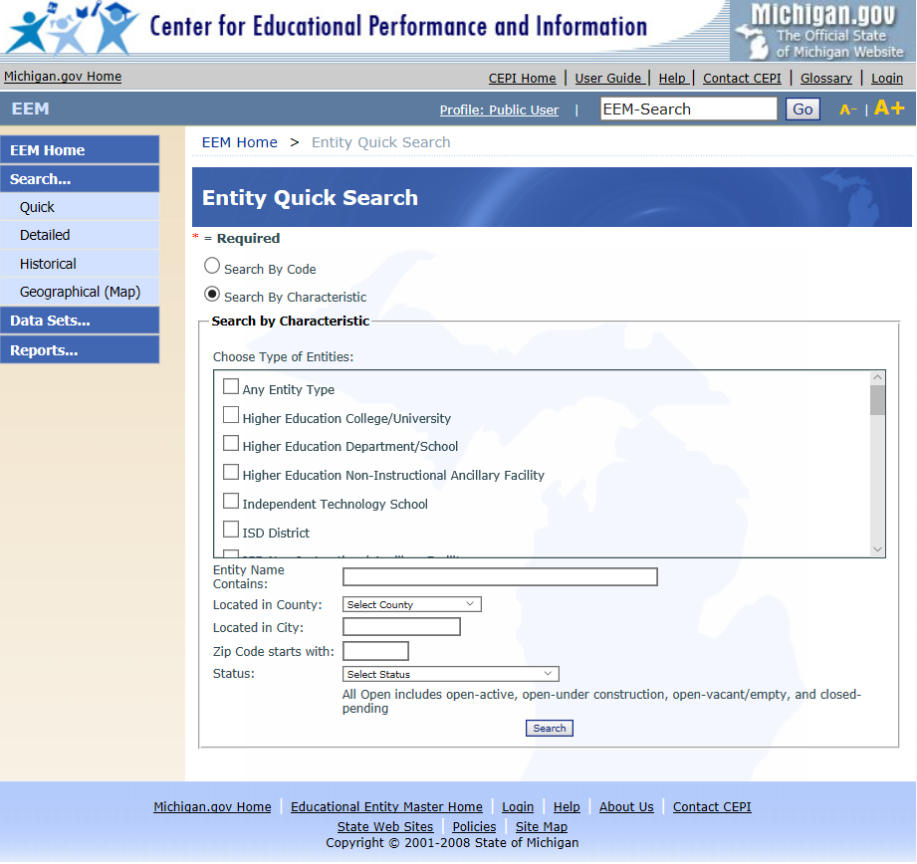
www.Michigan.gov/eem
Directions for Accessing Contacts in the Educational Entity Master (EEM)
Access the website: https://cepi.state.mi.us/eem/EntitySearchQuick.aspxClick “Search”
Select “Quick”
Under “Entity Name” type in the name of the local education agency (LEA)
Click “Search”
Select the district from the list (there may be several pages to look through), click on the blue underlined name
Scroll to the bottom of the page
Under the Admin/Contacts tab, using the scroll bar, find “Foster Care Liaison”
There will be a name and a phone number listed. If you would like an email address, click on the “Details” button to find the person’s contact email.

Slide 17
Best Interest Factors
Foster care workers must consider the following factors regarding school placement:
The parents or guardians and child’s school of preference.
Educational input from school personnel and district liaison.
The child’s/youth’s:
Social and emotional state
Academic achievement/strengths/weaknesses
Continuity of relationships
Special education programming
Extra-curricular activity participation
Distance/travel time to and from current school/new placement and the impact of commute on the child
Supportive relationships and/or services
Length of anticipated stay in placement and permanency plan

Slide 18
Michigan Revised School Code Act 451 MCL 380.1148(2)
In 2009, Michigan revised the school code:
A school district must allow a student to enroll in and attend the appropriate grade in the school selected by the Department of Health and Human Services or a child placing agency without regard to whether or not the student is residing in that district.
If the selection results in a student transferring to another school, the school records must immediately be transferred to that new school.

Slide 19
ESSA: DISPUTE INITIATION
Responsibilities during a dispute:
LEAs MUST ensure that children in foster care needing transportation to the school of origin receive such transportation in a cost-effective manner (ESEA 1112(c)(5)(B)(i)).
The LEA MUST provide or arrange for adequate and appropriate transportation to and from the school of origin while any disputes are being resolved. (This means paying 100% of all costs).

Slide 20
HOW TO INITIATE THE DISPUTE
The Dispute will be entered into the Grants Electronic Management System (GEMS) through the MDE Foster Care webpage link.
User should have a valid Michigan Education Information System (MEIS) ID.
Can enter as a guest, but there are limitations
Go to the MDE Foster Care webpage:
https://www.michigan.gov/mde/0,4615,7-140-81376_51051-428655--,00.html

Slide 21
MDHHS Education Planners
Specialized MDHHS staff that work with youth age 14 and up with open foster care cases on education issues.
18 planners that currently cover 48 counties.
Receive regular, ongoing detailed training:
Federal and state education law and policy
Federal and state child welfare law and policy
Special Education
Best interest determination
Higher education preparation and resources
Older youth resources

Slide 22
Foster Care Case Worker Responsibilities
Foster care case workers have full case responsibility.
Although Education Planners and Points-of-Contact can assist, it is the assigned case worker’s responsibility to ensure education continuity for children/youth.
Foster care case workers report quarterly on all case progress to the court. This includes education.

Slide 23
State Foster Care Point of Contact Responsibilities
State point of contact for the education of foster youth responsibilities will include but may not be limited to:
Provide professional development opportunities and technical assistance for LEA foster care liaison and other personnel regarding school stability and educational supports for children in foster care.

Slide 24
State Point of Contact for Foster Care Responsibilities Cont.
Coordinate with the corresponding State and Tribal Child Welfare agency POCs to issue joint State guidance for the implementation of the Title I, Part A provisions, which include:
Establish guidelines for transportation procedures, including how transportation will be addressed across district, county and State lines and what should be included in local transportation procedures.
Suggest criteria around the Best Interest Determination factors.

Slide 25
State Point of Contact for Foster Care Responsibilities Cont. 2
Facilitate data sharing with State and Tribal Child Welfare agencies, consistent with FERPA and other Federal or State privacy laws, regulations, and policies.
Monitor to ensure compliance with the Title I, Part A requirements at the LEA level.
EEM- Foster Care Liaison must be identified.
Foster Care Transportation Plan (MEMO sent in May of 2018).

Slide 26
District Foster Care Liaison Responsibilities
District foster care liaison responsibilities will include but may not be limited to:
Ensure that children in foster care are IMMEDIATELY enrolled in and are regularly attending school.
Ensure transportation procedures are in place to maintain students in their school of origin, when determined to be in their best interest.
*A Sample Procedure Document is available for download on MDE’s Foster Care webpage.
*The Direct Certification Report was updated December 4, 2018 to better reflect an accurate student count for LEAs.

Slide 27
District Foster Care Liaison Responsibilities Cont.
Participate with the Best Interest Determination when possible.
Facilitate the transfer of records when students are moved.
Facilitate data sharing with the Child Welfare Agencies, consistent with FERPA and other privacy protocols.
Facilitate transportation costs agreements between the LEA and the Child Welfare Agency.

Slide 28
Transportation Reimbursement
The following is the suggested structure reimbursing “additional costs” to transport foster students to the school of origin if determined to be in his/her best interest;
If a student’s foster care placement is being funded by Title IV-E funds, MDHHS will reimburse “additional transportation” costs at 100%.
If a student’s foster care placement is not being funded by Title IV-E, MDHHS will reimburse “additional transportation” costs up to 50% to aid LEAs (collaboration should continue).
OR; LEAs may fund the entire amount.

Slide 29
Transportation Reimbursement cont.
Child Welfare Workers have 30 days to make Title IV-E eligibility determination and notify LEAs.
During the window of Title IV-E eligibility determination, LEAs are responsible for providing transportation with possible 100% or up to 50% reimbursement for “additional cost” from MDHHS.
Child Welfare Workers are responsible for notifying LEAs if student’s placement Title IV-E eligibility changes.
LEAs may use Title I, Part A funds to cover non-reimbursed costs for “additional transportation”.

Slide 30
Definition of “Additional costs” for transportation
“Additional costs incurred in providing transportation to the school of origin should reflect the difference between what an LEA otherwise would spend to transport a student to his or her assigned school and the cost of transporting a child in foster care to his or her school of origin. “
*Non-Regulatory Guidance Question #27

Slide 31
UPDATES
Direct Certification Report
LEA Foster Care Transportation Plan/Procedure due in GEMS 10/1/18
Educational Entity Master- please verify information regularly
Regional Training Opportunities
Updated MDE Foster Care webpage
K-12 Action Network

Slide 32
Resources
US ED/HHS Joint Foster Care Guidance
https://www2.ed.gov/policy/elsec/leg/essa/edhhsfostercarenonregulatorguide.pdf
Partner Agencies
Fostering Success Michigan: http://fosteringsuccessmichigan.com/
The New Foster Care: http://thenewfostercare.org/
Michigan’s Children: https://www.michiganschildren.org/
State of Michigan Websites
http://www.michigan.gov/mde/0,4615,7-140-6530_30334_51051-428655--,00.html
http://www.michigan.gov/mdhhs/0,5885,7-339-71551_11120_78699---,00.html
https://dhhs.michigan.gov/OLMWeb/ex/FO/Public/FOM/000.pdf#pagemode=bookmarks

Slide 33
Questions
Ann Rossi RossiA@michigan.gov 517-241-9748 Kathleen Hoehne hoehnek@Michigan.gov 517-241-6970

